Slide 1

BEATFINDER
GO BEYOND!!
BY :
LAVITRA - PES1201800137
ARJUN - PES1201800119
RAHUL - PES1201800146
ANIRUDH - PES1201802069

Slide 2
ABOUT THE PROJECT
Our aim was to create a music Website that is Free and Easy to use for everyone around the globe.
We have made the website simple, yet versatile. The user can play songs based on specific preferences like Genre, Artist, or even search for a particular song.
Basic SignUp/LogIn procedure and preferences, history management gives a comfortable personalised touch to the website

Slide 3
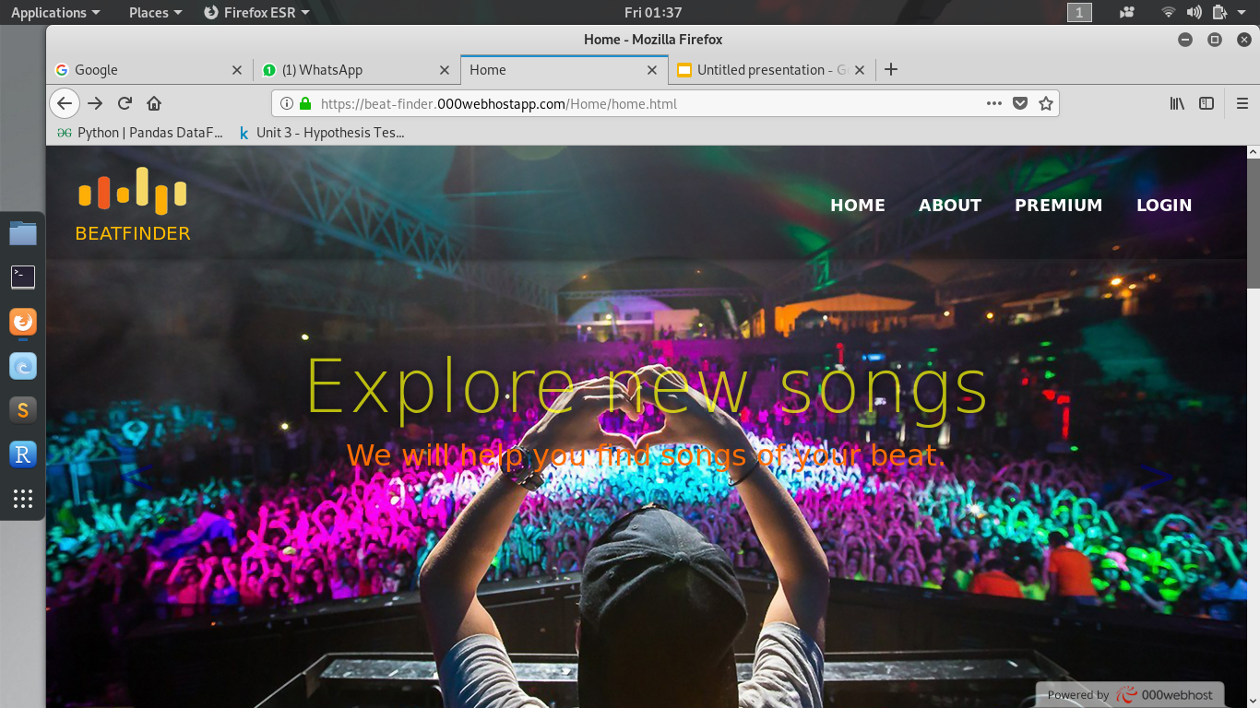
TOOLS AND LANGUAGES USED TO CREATE BEATFINDER
HTML5
CSS
BOOTSTRAP
JAVASCRIPT
JQUERY
PHP
AJAX
PYTHON
VEVO(YT)
A SNEAK-PEEK AT THE WEBSITE HOME PAGE

Slide 4
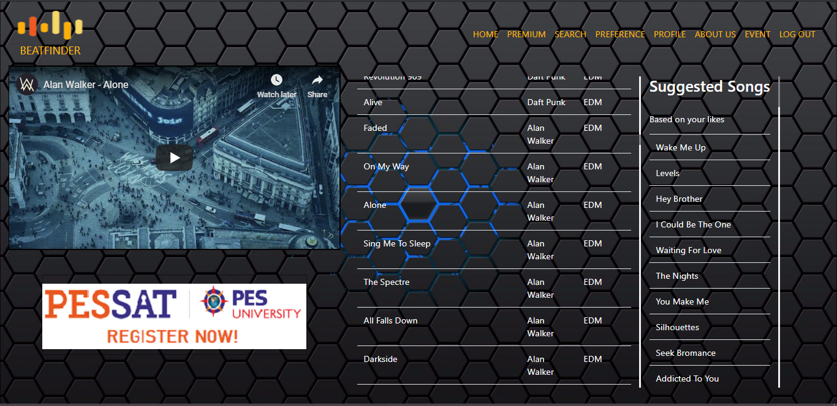
THE MAGIC BEHIND
Since no good dataset was available online which we felt could meet the end-users need, we made our very own dataset for the backend.
With over 700+ songs from a wide range of selections, the website offers only the best quality of songs for the user to dive in.

Slide 5
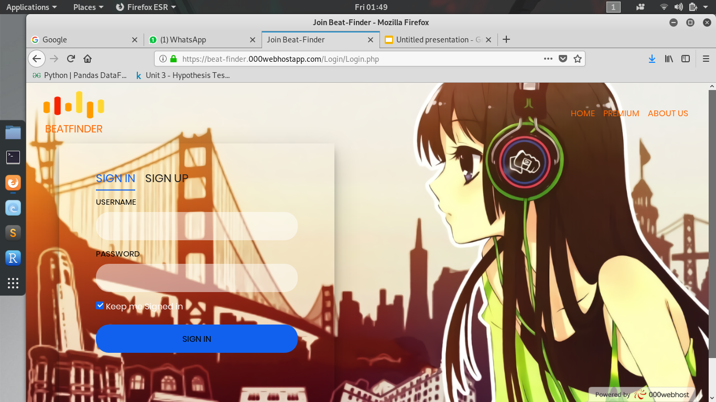
PERSONALISED FOR YOUR NEEDS
Each user is unique. To tackle this challenge we have a login portal. Each user can register to the website and enjoy personalised content.
Previously played and Suggested songs are some of the added advantage a user can have if he signs up in the website.
With a backend coded with PHP, the login/signup interface is simple and secure.

Slide 6
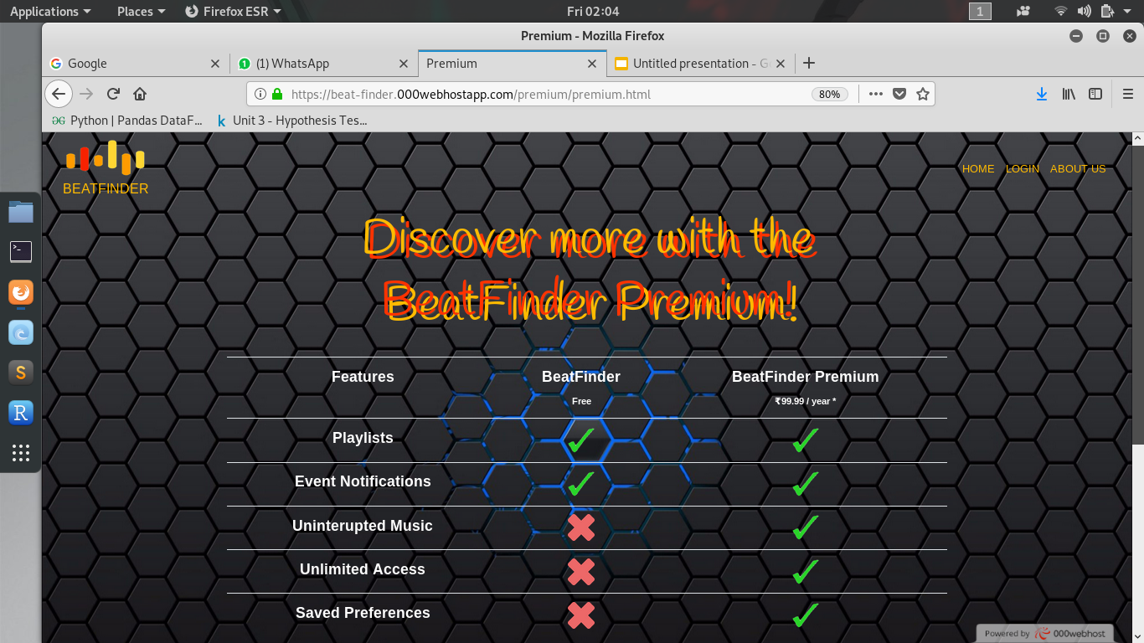
SCOPE OF IMPROVEMENT AND
FUTURE ENDEAVOURS
Scope of Improvement in algorithms for search as well as suggested songs are always present.
The need for auto-updating the songs and musical events using various APIs is evident.
We plan on adding a feature that will enable user to download the songs to play it offline whenever required.
COMING SOON! “BEATFINDER PREMIUM”

Slide 7
THANK YOU!
END OF PRESENTATION

